Slide 1
Initial Analysis of
Covid-19
Shobair Abidi

Slide 2
Preliminary Setup

Slide 3
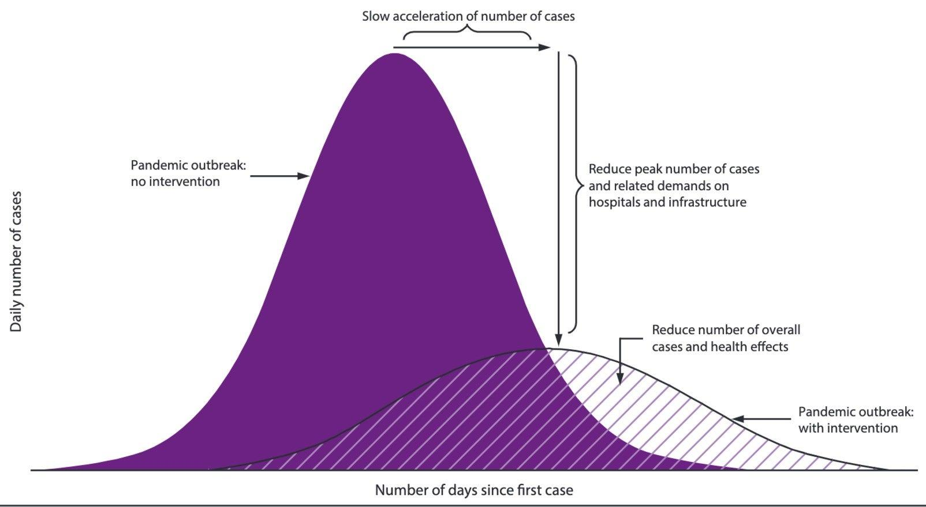
Purpose
Contagion spread
Correlation
Countermeasures
Accelerating affects
Climate
Flatten the Curve

Slide 4
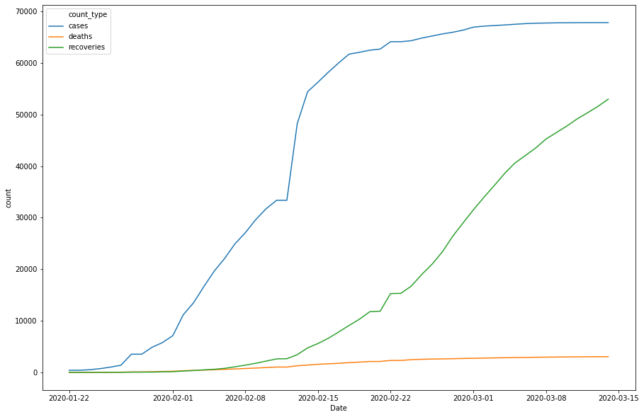
Dataset
Defining Critical Values
Rate of change in Cases, Deaths, and Recoveries
Day Zero
Choosing Dataset
Picking Correlation to test
Link

Slide 5
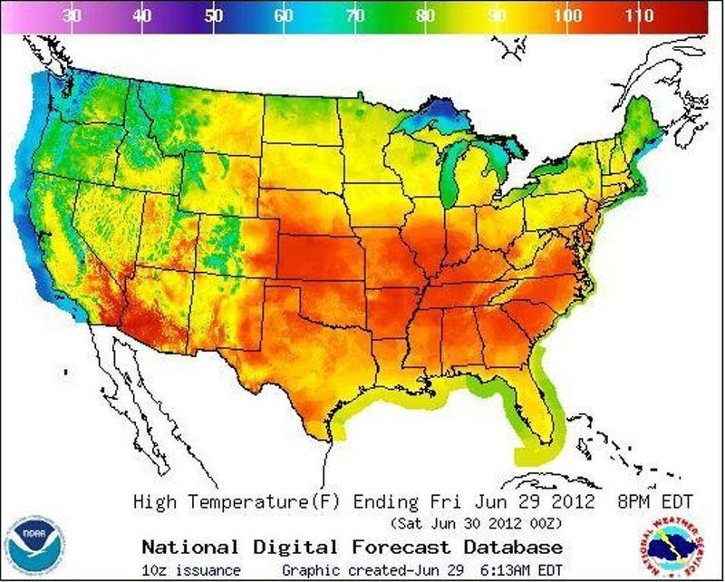
Weather
Max Temperature / Week
Min Temperature / Week
Mean Temperature / Week
Temperature Differential / Week
Climate

Slide 6
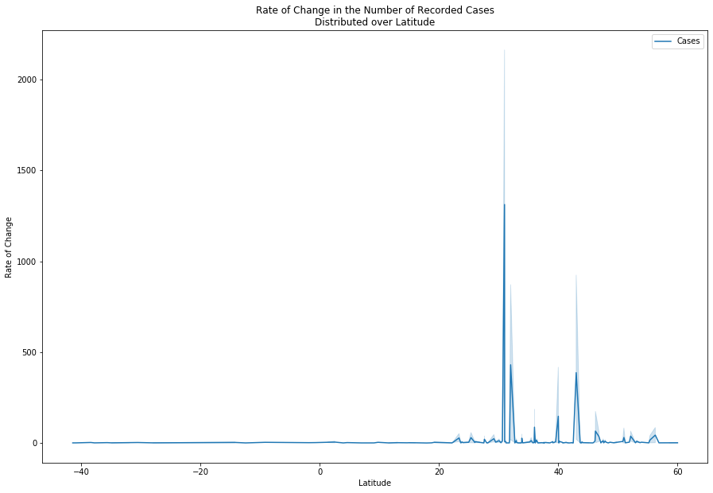
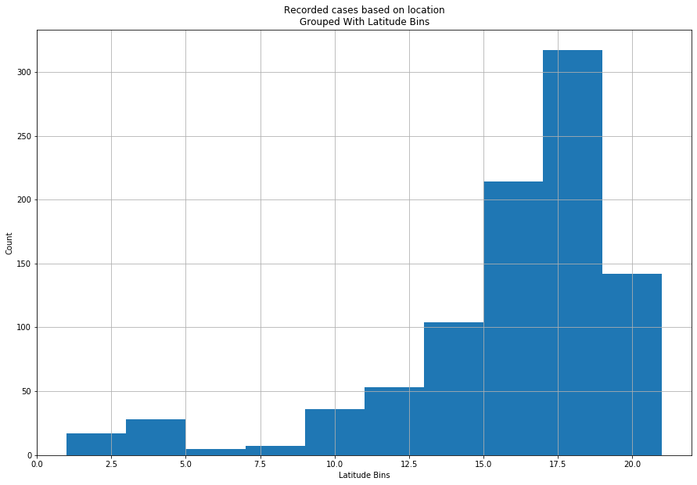
Latitude

Slide 7
What can we derive without correlation?

Slide 8
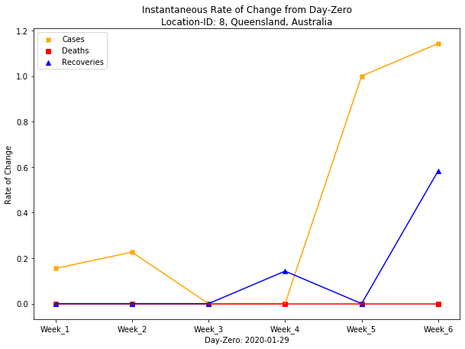
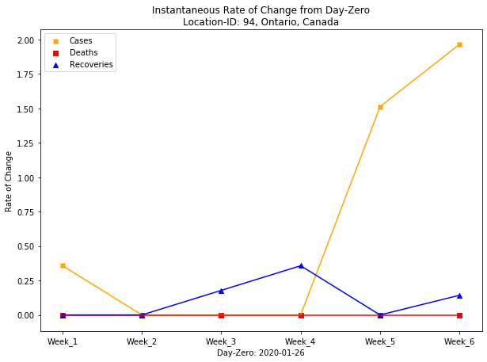
What Now?

Slide 9
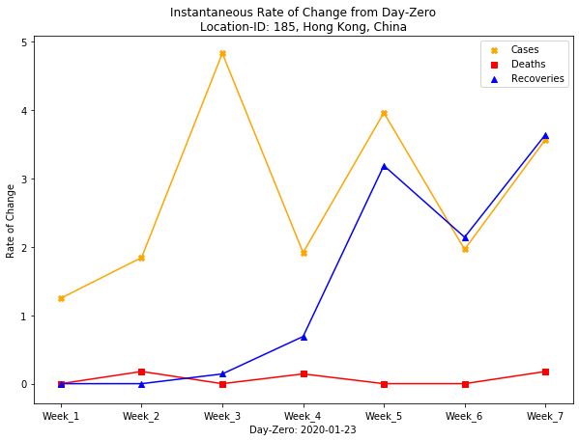
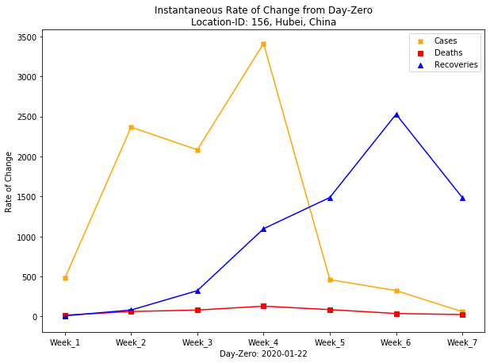
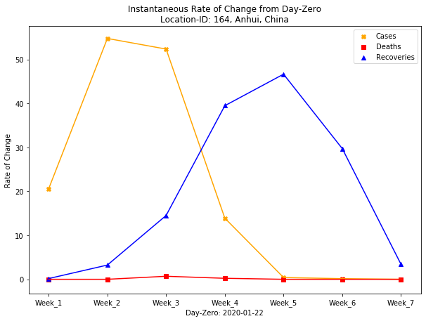
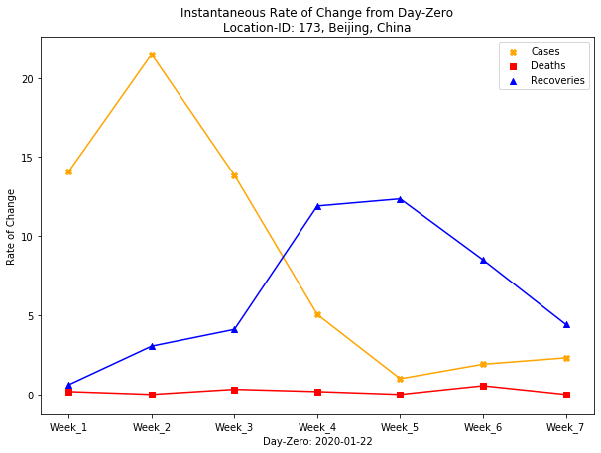

Slide 10
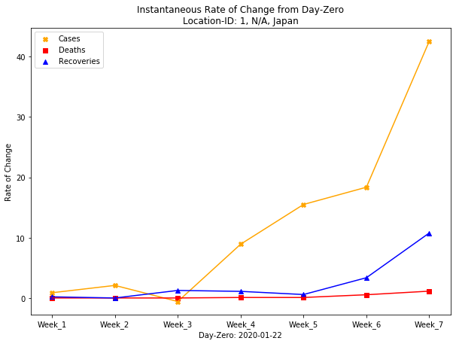
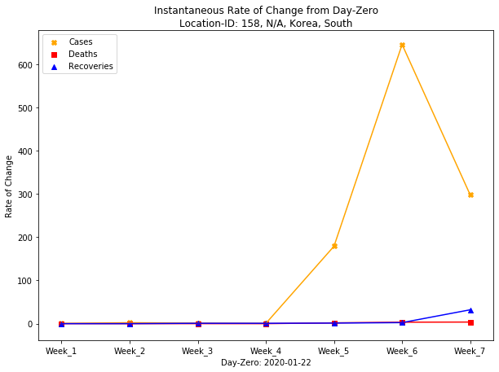
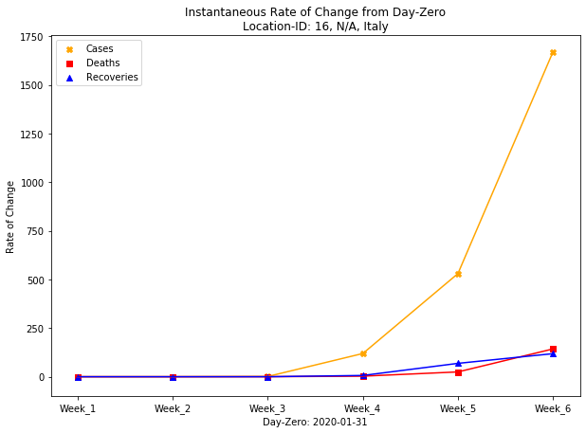
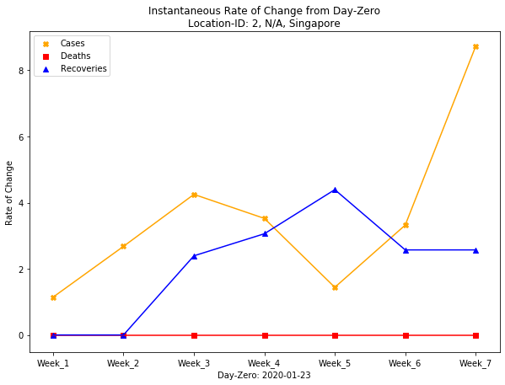

Slide 11
Conclusion

Slide 12
Summary
Lack of correlation
Further exploration
Patient demographics
Population analysis
Air quality
Comparison to Previous Pandemics
SARS
MERS

Slide 13
Questions?

